Slide 1

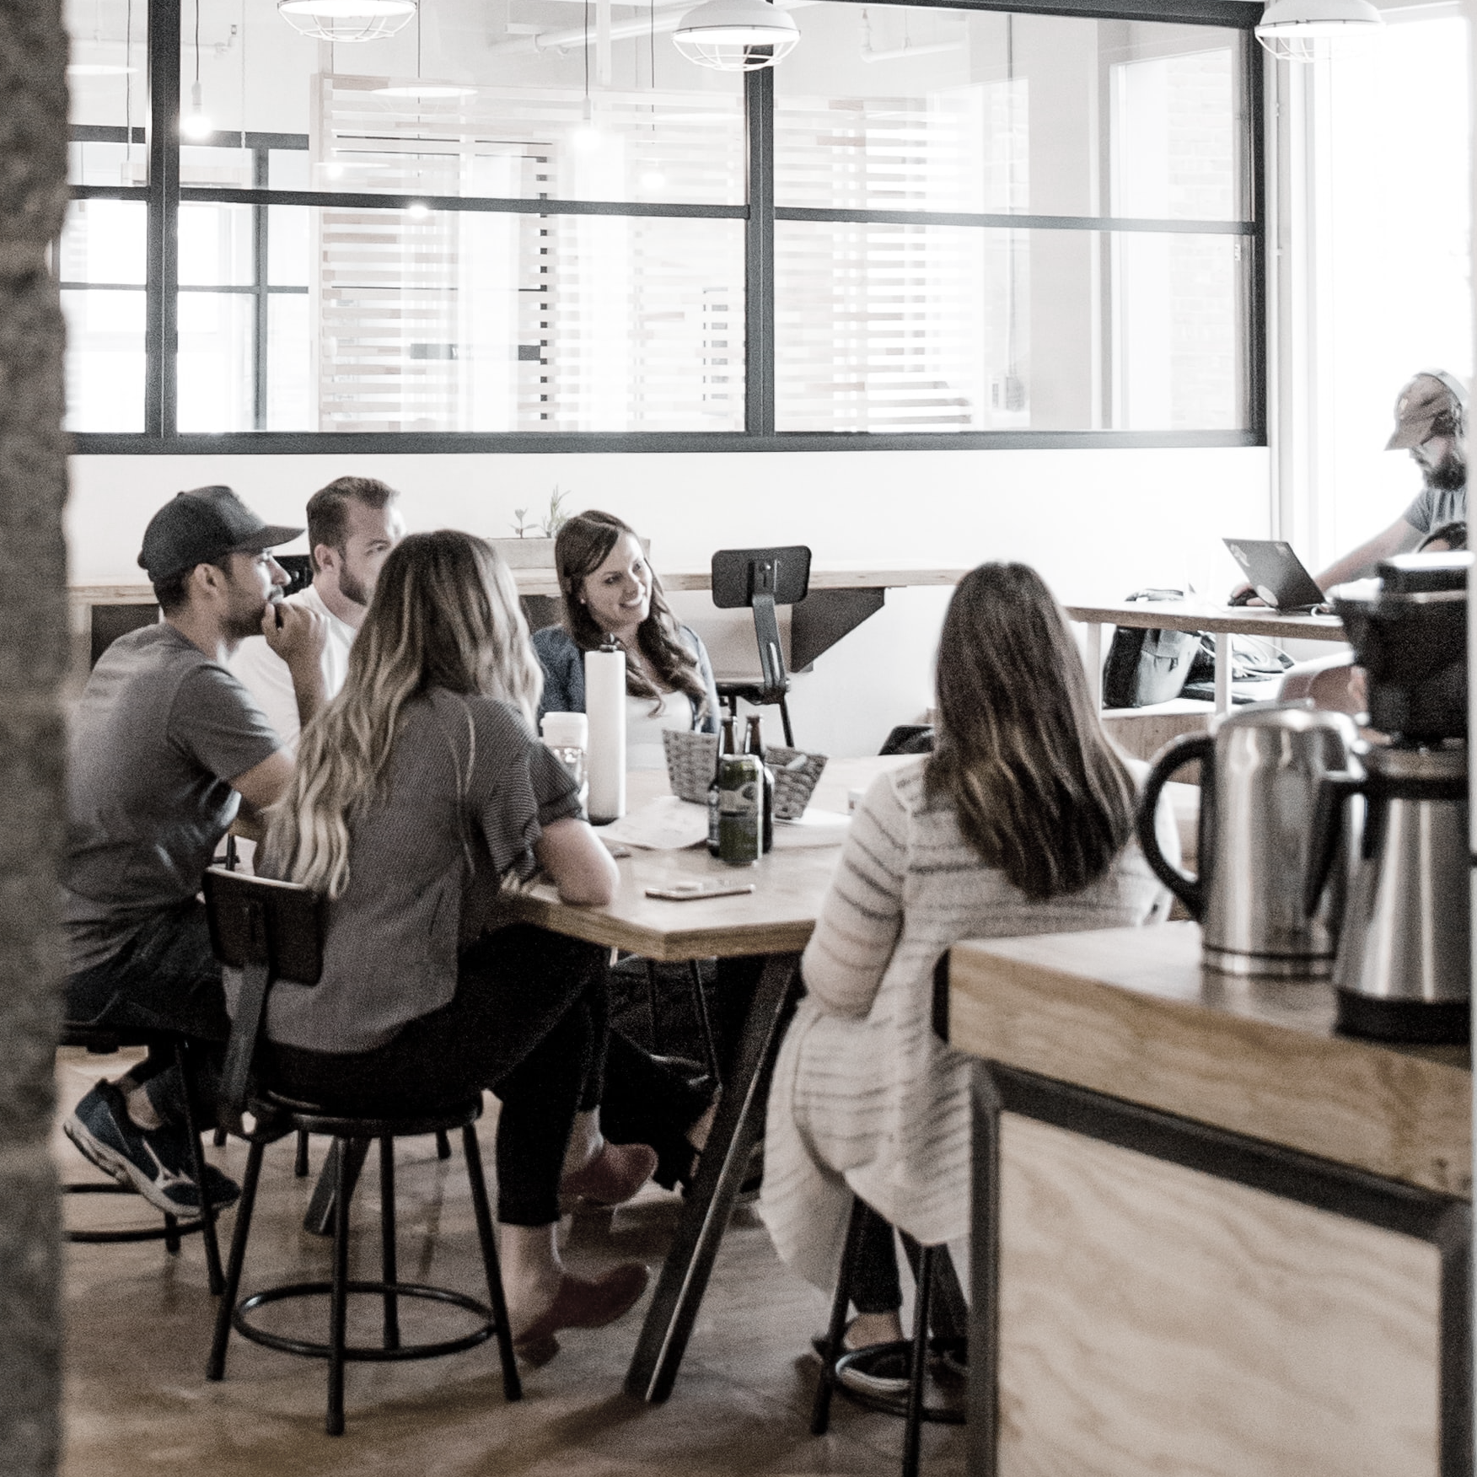
nickable
charts.
August 2021

Slide 2
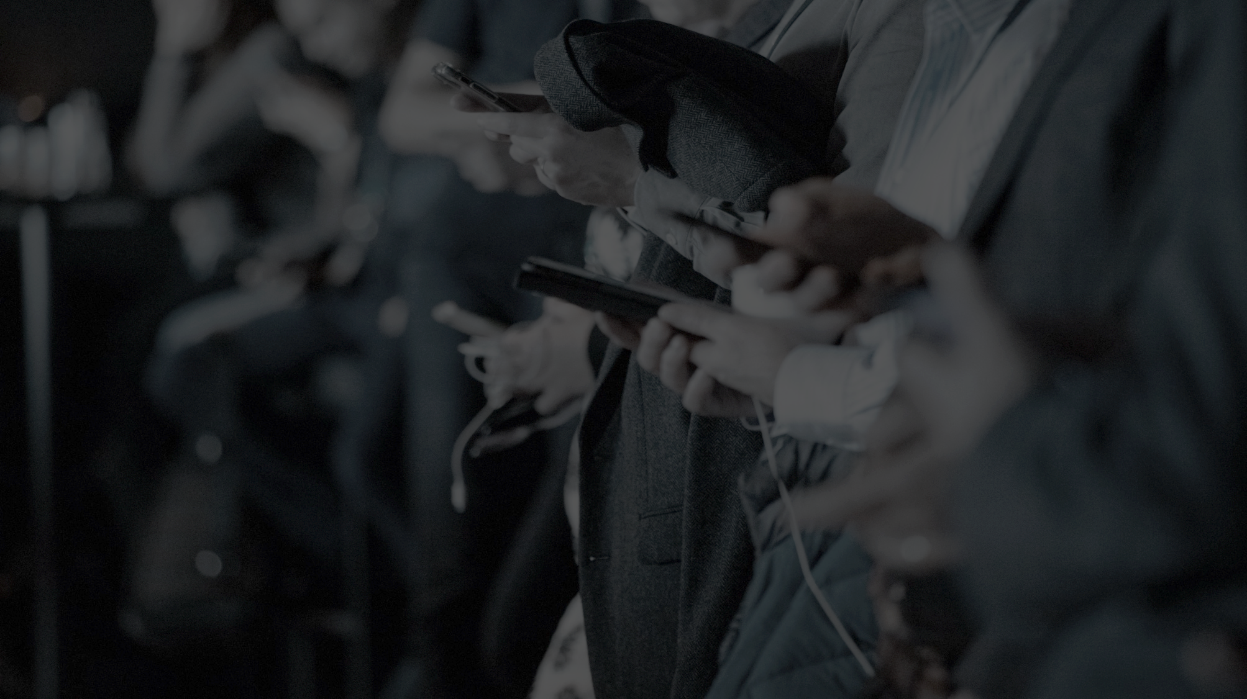


australian digital media consumption.
21 million
australians (age 2+) were online this month
$9.5 billion
digital ad market supports this content consumption
Source: Nielsen Digital Content Planning, April 2021, Text, Digital (C/M), People 2+, Unique Audience; IAB Australia Online Advertising Expenditure Report CY2020 prepared by PWC

Slide 3

consumer trends charts.

Slide 4




australians continue to access
online content daily across multiple screens.
mobile
desktop
connected tv
tablet
17.7 million
8.5 million pc
2.9 million mac
7.3 million
4.1 million ipad
1.4 million android
  average 6.7 video capable screens per household
Source; IAB Australia Nielsen Digital Enumeration Study March 2021 – May 2021 quarter ages 14+ n=3000 per quarter;
ThinkTV TV Fact Pack Tech Penetration H2 2020

Slide 5
connected tv audience continues to grow.
view internet content on a connected tv daily
11 million
Australians
have ever viewed Internet content on a TV screen,
7% YOY increase
over 7 million
view daily.
Source; IAB Australia Nielsen Digital Enumeration Study March 2021 – May 2021 quarter ages 14+ n=3000 per quarter
Source; IAB Australia Nielsen Digital Enumeration Study March 2021 – May 2021 quarter ages 14+ n=3000 per quarter

Slide 6
smart speaker ownership at 20%
of australians aged 14+.
% with a smart speaker at home
4.3 million
Australians own a Smart speaker.
Of these, 33% use it daily and 65% at least weekly.
6
Source; IAB Australia Nielsen Digital Enumeration Study March 2021 – May 2021 quarter ages 14+ n=3000 per quarter

Slide 7
2021 digital content consumption tracking above 2019 and above this time last year.
total time for total audience of top 150 tagged digital content brands
CY to date
total time spent on top 150 brands up 15% on 2019
Source; Nielsen Digital Media Ratings Volumetrics Monthly Tagged, January 2019 – July 2021, P2+, Digital c/m, Text, Top 150 brands, Total Time Spent
Notes:
January 2021 up 10% year on year; February 2021 -3% year on year.

Slide 8
covid lockdowns driving digital news content consumption lift over june and july.
total time spent for total audience of tagged news brands
July 2021 time spent up 5% YoY and 60% on 2019 driven by COVID lockdowns and start of the Olympics
CY to date
total time spent on digital news content up 38% on 2019.
Source; Nielsen Digital Media Ratings Volumetrics Monthly Tagged, January 2019 – July 2021, P2+, Digital c/m, Text, Current Events and Global News sub-category, Total Time Spent
Notes:
January 2021 up 10% year on year; February 2021 -3% year on year.

Slide 9
market growth lifted interest in real estate over the second half of 2020 and into 2021.
total time spent for total audience of tagged real estate brands
CY to date
total time spent on real estate content up 14% YoY and 44% on 2019.
Source; Nielsen Digital Media Ratings Volumetrics Monthly Tagged, January 2019 – July 2021, P2+, Digital c/m, Text, Real Estate sub-category, Total Time Spent
Notes:
January 2021 up 10% year on year; February 2021 -3% year on year.

Slide 10
rediscovery of home cooking and recipes lifting online time again in July this year.
total time spent for total audience of tagged food and cooking brands
CY to date
total time spent on online recipe content up 9% on 2019.
Source; Nielsen Digital Media Ratings Volumetrics Monthly Tagged, January 2019 – July 2021, P2+, Digital c/m, Text, Food and cooking sub-category, Total Time Spent
Notes:
January 2021 up 10% year on year; February 2021 -3% year on year.

Slide 11
Behavioral shift from covid lockdowns driving up time spent with major retailers online.
total time spent with online major retailers
On average
17 million Australians visited a major retailer online each month this year.
Peak month April 2020 time spent up 16% on month prior
Christmas retail
17.5 million Australians shopping in December
Source; Digital Content Planning, January 2020 to May 2021, Text, Digital (C/M), Person 18+, Mass Merchandiser subcategory, total time spent

Slide 12
expenditure charts.

Slide 13
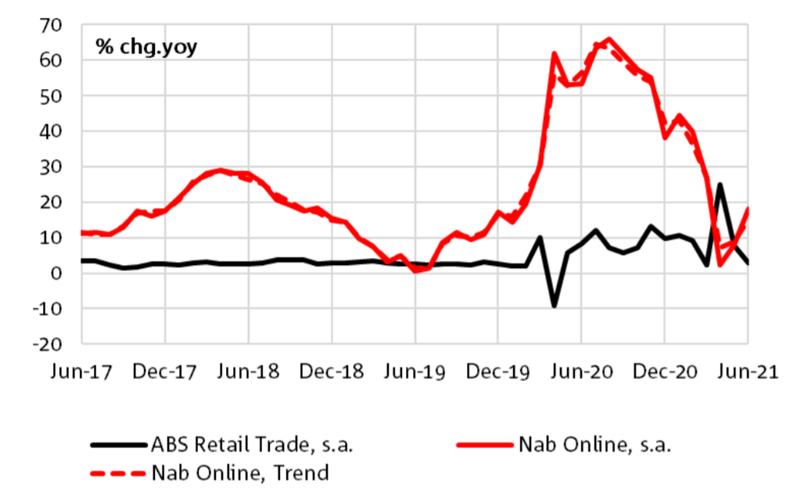
australian consumer online retail spend has grown 35% year on year for FY21.
NAB online retail sales and ABS retail sales
Australians spent $48.6 billion
on online retail in FY21, around 13.3% of the total retail trade estimate.
Sources: NAB Online Retail Sales Index June 2021, Australian Bureau of Statistics (ABS).

Slide 14
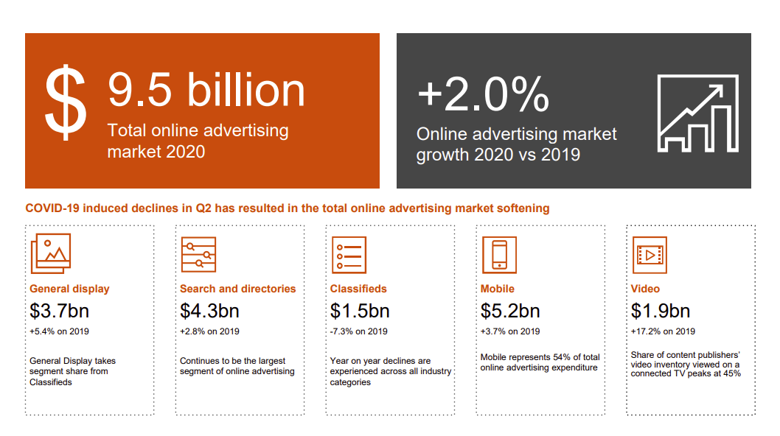
online advertising expenditure CY20.
Source; IAB Online Advertising Expenditure Report CY and quarter ending December 2020 Compiled by PWC

Slide 15
quarterly online advertising expenditure.
quarterly online advertising expenditure
All categories have rebounded from COVID onset decline in first half of 2020
Source; IAB Online Advertising Expenditure Report CY and quarter ending March 2021Compiled by PWC

Slide 16
online advertising expenditure comparison.
Globally digital advertising investment outperformed other media channels and saw year on year growth in an economically challenged and unstable environment.
market growth comparison 2020 v 2019
 | Australia | UK | US
Total digital market | 2% | 12% | 5%
Display | 5% | 16% | 11%
Video (subset of display) | 17% | 21% | 19%
Search | 3% | 24% | 7%
Classifieds | -7% | 2% | -30%
Sources; IAB Australia Online Advertising Expenditure Report CY20, IAB Internet Advertising Report Full Year 2020, IAB UK Digital Adspend Study 2020

Slide 17
online advertising expenditure forecast.
PWC online media and entertainment report 2021 - 2025
Australian online advertising expenditure forecast ($ million)
Total online advertising
2019-2025
CAGR 5.5%
Display
CAGR 8.4%, driven by video at 14.5%
Source; PWC Online Media and Entertainment Outlook Report 2021 - 2025

Slide 18
effectiveness charts.

Slide 19
all digital formats can help build brands.
the digital brand effect
Kantar’s Digital Brand Effect Report with the IAB found digital advertising is effective at delivering brand impact and has a marketing role beyond that of short-term sales
average campaign impact per person reached
Source; Kantar IAB Digital Brand Effect Report 2019

Slide 20
digital retains brand impact.
the digital brand effect
Kantar’s Digital Brand Effect Report with the IAB found that the brand impact of digital campaign exposure is retained well after the campaign ends and this retention is comparable to offline media channels.
% retained brand impact after advertising ends
8 weeks after flighting, digital media retains over 20% of original brand impact
Source; Kantar IAB Digital Brand Effect Report 2019

Slide 21

more research and resources
www.iabaustralia.com.au
T (02) 9211 2738
E iabaustralia@iabaustralia.com.au
A Suite 101, Level 1, 54 Foveaux St, Surry Hills, 2010
iabaustralia.com.au

