Slide 1


Slide 2

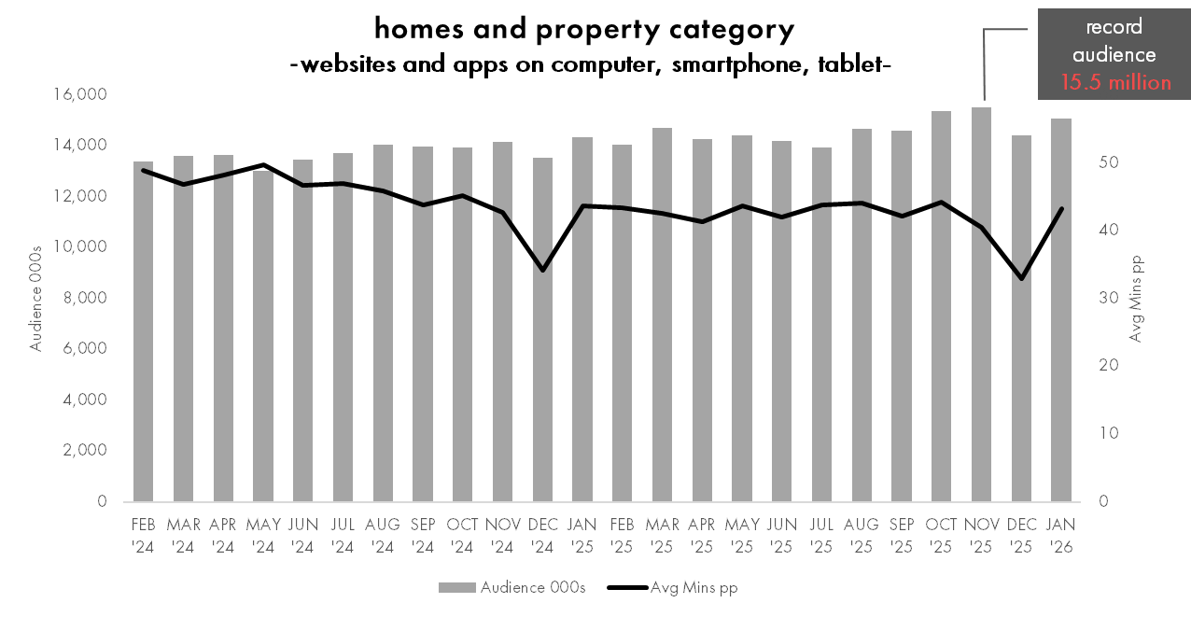


usage of property websites and apps peaked in November 2025 with the highest monthly audience on Ipsos iris records
15.1 million
Australians aged 14+ used a homes and property website or app, (up 5 % Y o Y),
spending over 43 minutes per person
in January 2026.
Source: Ipsos iris Online Audience Measurement Service February 2024 – January 2026 (year on year January 2026 v January 2025), Age 14+, PC/laptop/smartphone/tablet, Audience (000s), Average minutes per person, Homes and property category

Slide 3
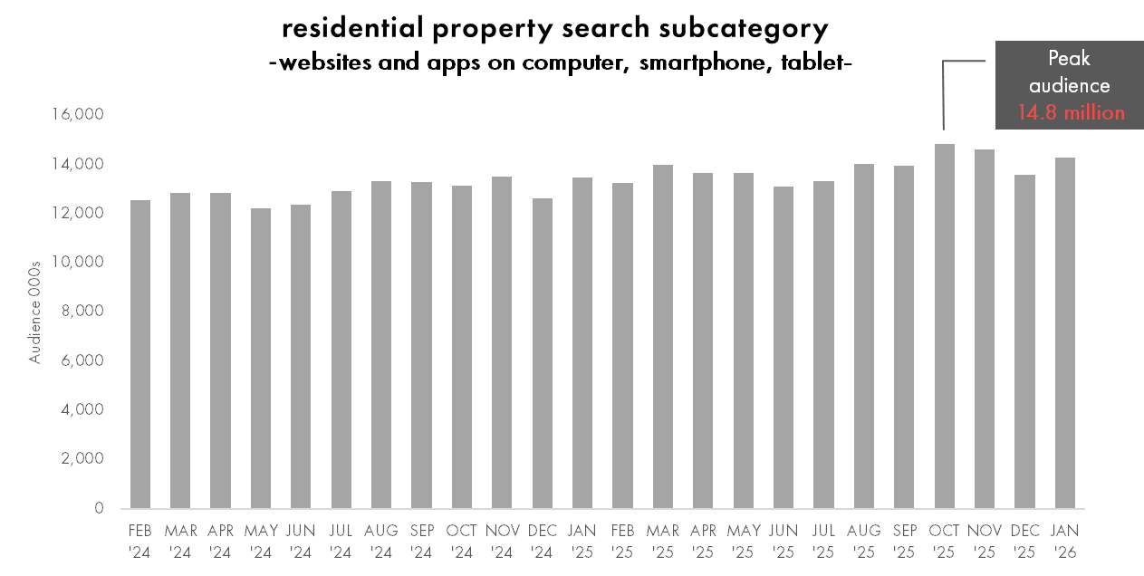
usage of residential property search website or app increased 6% year on year in January 2026
14.3 million
Australians aged 14+ used a residential property website or app in January 2026, up 6% year on year.
Source: Ipsos iris Online Audience Measurement Service February 2024 – January 2026 (year on year January 2026 v January 2025), Age 14+, PC/laptop/smartphone/tablet, Audience (000s), Residential Property Search subcategory

Slide 4
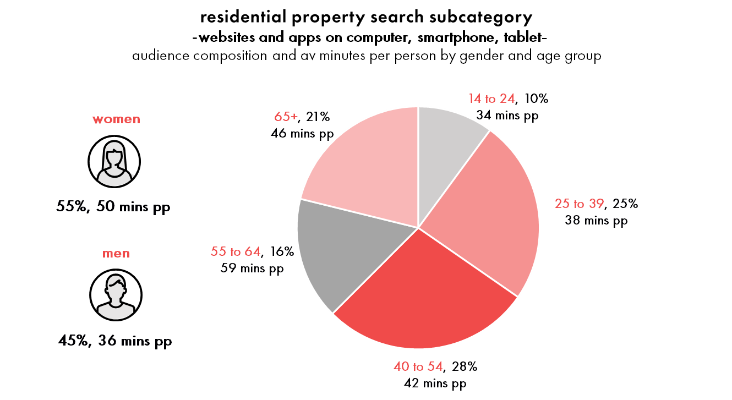
women spent 41% more time pp than men using residential property search websites and apps in January 2026
14.3 million
Australians aged 14+ used residential property search websites and apps,
spending on average over 43 minutes pp
in January 2026.
Source: Ipsos iris Online Audience Measurement Service January 2026, Age 14+, PC/laptop/smartphone/tablet, Audience (000s), Audience composition %, Avg time pp (minutes), Residential Property Search subcategory

Slide 5
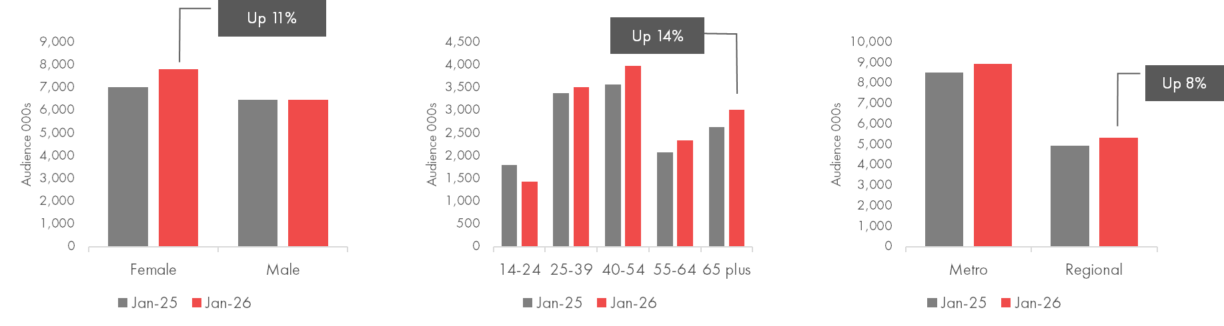
residential property search audience grew 6% overall, with greater growth in female, age 65+ and regional audiences
residential property search subcategory -websites and apps on computer, smartphone, tablet- audience 000s by gender, age group and region year on year change January 2025 v January 2026
Source: Ipsos iris Online Audience Measurement Service January 2026 (year on year January 2026 v January 2025), Age 14+, PC/laptop/smartphone/tablet, Audience (000s), Residential Property Search Subcategory

Slide 6
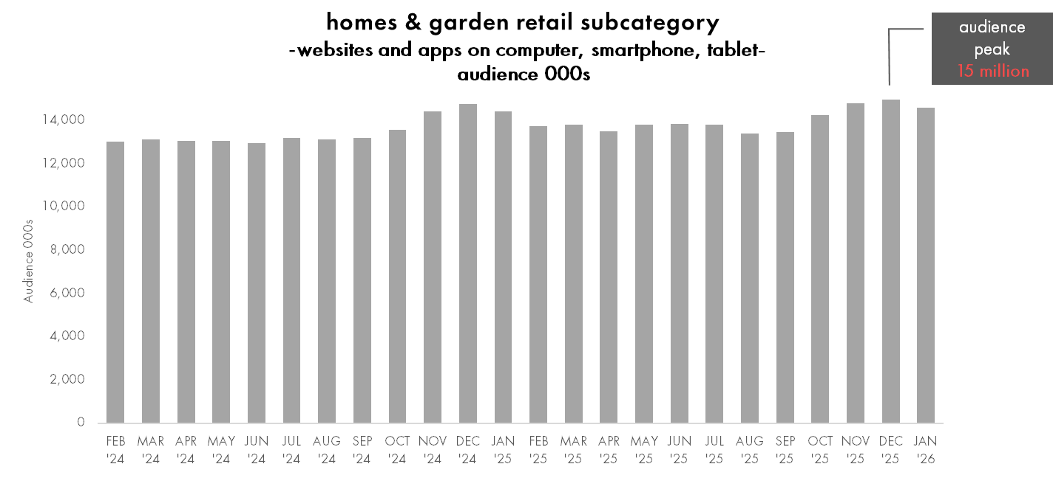

activity with homes and garden retail websites and apps peaks over the summer months
14.6 million
Australians aged 14+ used a homes and garden retail website or app in January 2026, for example, Bunnings, Ikea, Temple & Webster, Mitre 10, Appliances Online, websites and apps
Source: Ipsos iris Online Audience Measurement Service February 2024- January 2026, Age 14+, PC/laptop/smartphone/tablet, Audience 000s, Retail & commerce/homes & gardens subcategory

Slide 7
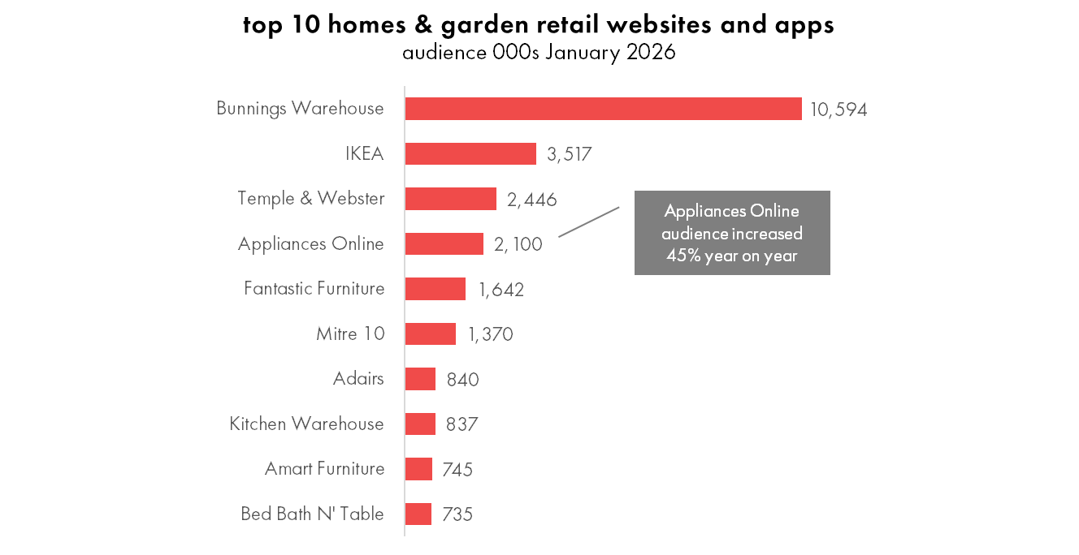
females dominate total time spent on homes and garden retail websites and apps
14.6 million
Australians aged 14+ used a homes and garden retail website or app in January 2026.
58% of total time spent is by females and 32% of the by females aged 25-54.
Source: Ipsos iris Online Audience Measurement Service January 2026, Age 14+, PC/laptop/smartphone/tablet, Audience 000s, Total time minutes composition %, Retail & commerce/homes & gardens subcategory

Slide 8
Ipsos iris, IAB endorsed digital audience measurement currency
Endorsed by the IAB as the sole and exclusive preferred supplier of digital audience data, Ipsos iris has been delivering market-leading insights from January 2023.
Ipsos iris serves as an inclusive, standardised industry currency, offering consistent and comparable digital audience insights for over 10,000 websites and more than 2,200 apps, capturing the online behaviours of more than 22 million Australians aged 14+ across Smartphone, Computer and Tablet devices.
Key data integrations with OzTAM for BVOD and Google for YouTube have extended the most complete view of Australians’ digital behaviour into the coverage of audiences on Connected TV to empower agencies, marketers and publishers to plan with confidence.
Ipsos iris integrates a range of data inputs to create a data set of around 500,000 synthetic respondents. Ipsos iris data inputs include on ongoing establishment survey of 12,000 per year, a single source, passive panel of 4,000 across 8,500 devices, census data from comprehensive tagging coverage of content owners and data integrations from Apple, Google and OzTAM.
Governance of Ipsos iris includes close and continuous oversight by the IAB Audience Measurement Council (made up of research professionals from 12 media owners) who regularly review KPI’s, panel health and methodology, along with data integrity, availability, delivery and usage.
Further insights and information on Ipsos iris is available in IAB Australia nickable charts and at iris-au.ipsos.com

