Slide 1


Slide 2

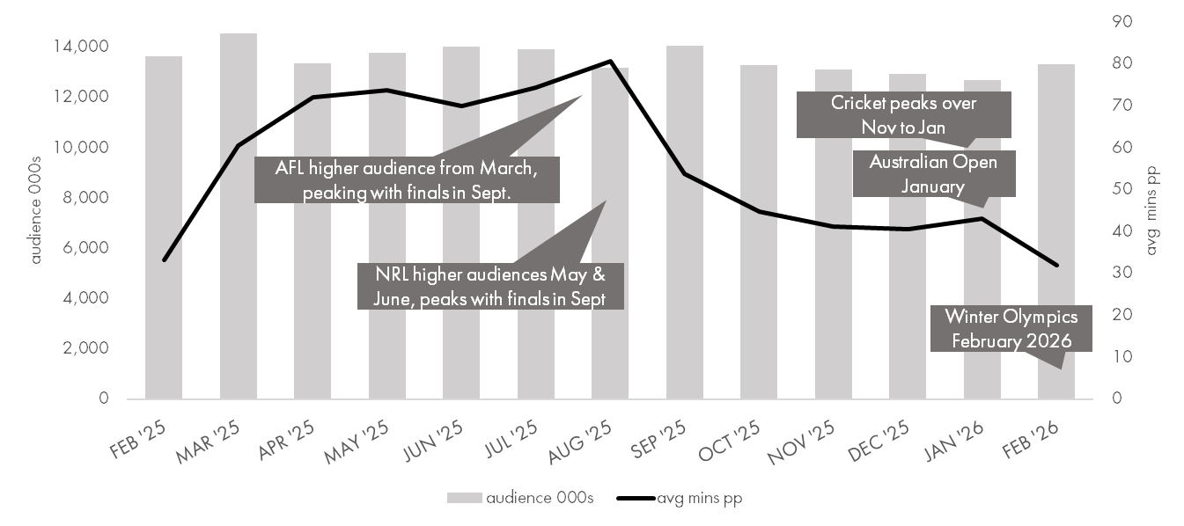


various online sports codes and events drive audience and time spent with online sports content
online sports category
- audience 000s and average minutes pp, websites and apps on computer, smartphone, tablet -
13.5 million
Australians aged 14+ visited an online sports website or app
on average each month over the last year
(Mar 25 – Feb 26).
Various sports events drive online time with audience peaking in March with the start of AFL and NRL seasons.
Source: Ipsos iris Online Audience Measurement Service February 2025 – February 2026, Age 14+, PC/laptop/smartphone/tablet, Sport category, Audience (000’s), Avg minutes pp

Slide 3
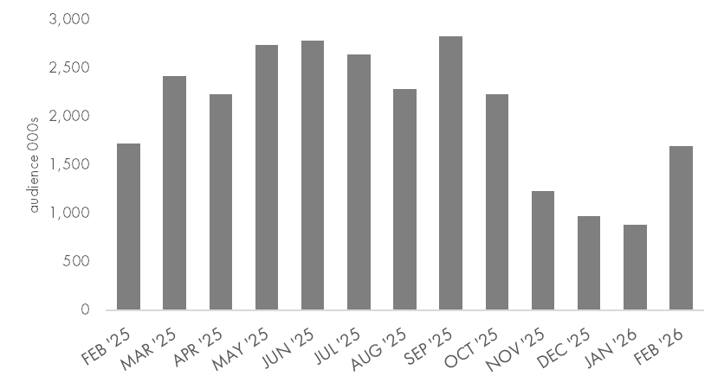
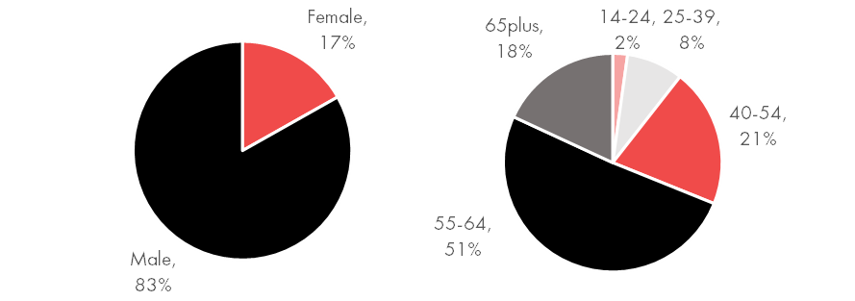
on average over 2.5 million Australians visit NRL online during season months, including over 700,000 on average using the live official app
National Rugby League
- Brand Group (incl nrl.com, official app, tipping and teams' websites)
audience 000s websites and apps on computer, smartphone, tablet-
audience 000’s by month
monthly audience peaks in September with finals series
gender and age composition of total time February 2026
over 70% of time spent is by 40- to 64-year-olds
Source: Ipsos iris Online Audience Measurement Service February 2025 – February 2026, Age 14+, PC/laptop/smartphone/tablet, National Rugby League Brand Group, App, audience 000s, total time composition (average over season March 2025 – October 2025)

Slide 4
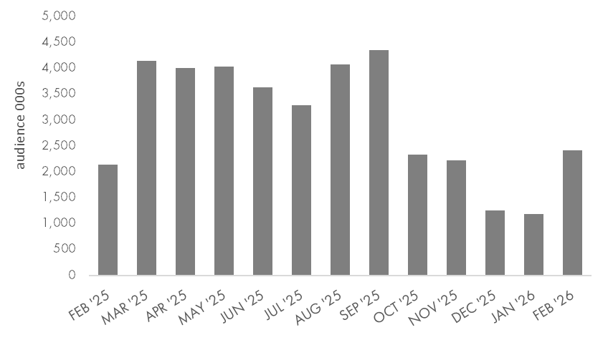
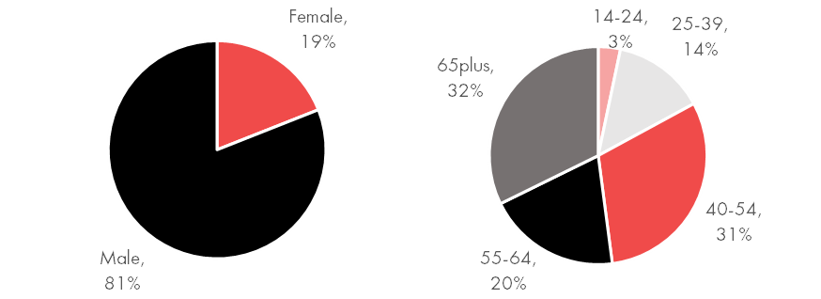
on average over 3.7 million Australians visit AFL online during season months, including 1.9 million using the live official app
Australian Football League
- Brand Group (incl afl.com, official app, tipping and fantasy and teams' websites)
audience 000s websites and apps on computer, smartphone, tablet-
audience 000’s by month
monthly audience peaks in September with finals series
gender and age composition of total time February 2026
over 80% of time spent is by 40 plus year-olds
Source: Ipsos iris Online Audience Measurement Service February 2025 – February 2026, Age 14+, PC/laptop/smartphone/tablet, Australian Football League Brand Group, App, audience 000s, total time composition, (average over season March 2025 – October 2025)

Slide 5

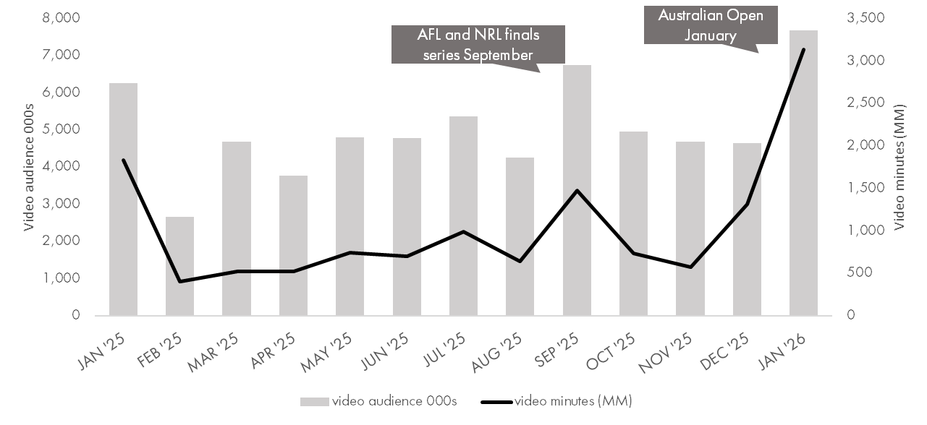
over 7.6 million watched BVOD sports programs in January, up 65% on previous month driven by the Australian Open
video viewing BVOD online sports events and programs*
- video audience 000s and video minutes (MM), BVOD on CTV, computer, smartphone, tablet -
4.9 million
Australians aged 14+ viewed BVOD online sports events & programs
on average over last year (Feb 25 – Jan 26).
Audience lifted 65% and total time spent lifted 139% from December to January due to Australian Open tennis.
Source: Ipsos iris Online Audience Measurement Service January 2025 – January 2026, Age 14+, CTV/PC/laptop/smartphone/tablet, Video audience (000’s), Total video minutes (MM)
*ABC iView, 9Now, SBS on Demand, 7Plus, 10 Play, Sports Events and Sports Programs, CTV Published Database

Slide 6
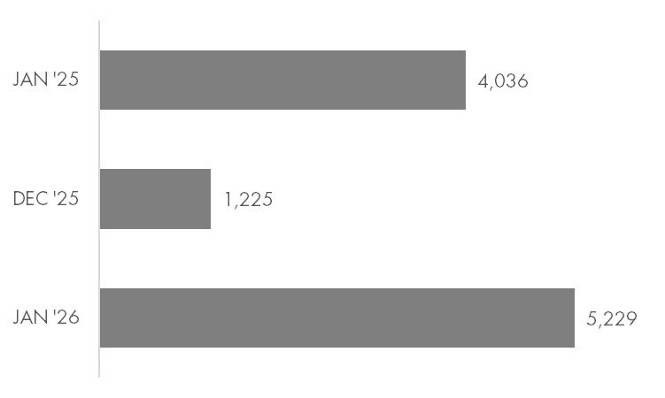
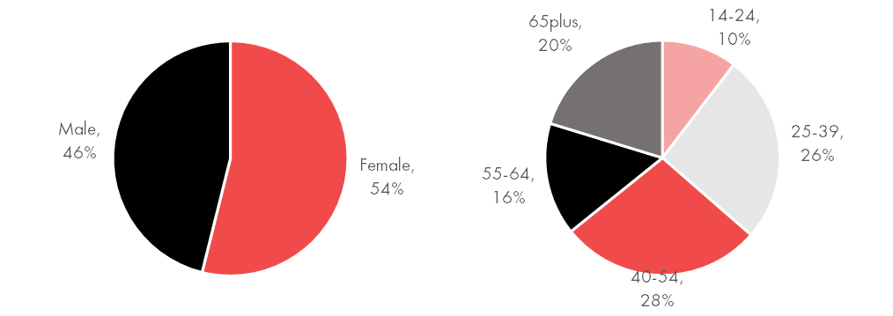
Australian Open attracts female and younger viewers to 9Now BVOD sports programs in January 2026
9Now Sports Events and Programs
BVOD video audience 000s websites and apps on CTV, computer, smartphone, tablet-
video audience 000’s by month
monthly video audience up 30% year on year and over 300% month on month
gender and age composition of video audience January 2026
54% of the video audience were aged 25-54
Source: Ipsos iris Online Audience Measurement Service January 2025, December 2025, January 2026, Age 14+, CTV/PC/laptop/smartphone/tablet, video audience (000’s), video audience composition
9Now Sports Events/Sports Programs, CTV Published Database

Slide 7
source
Ipsos iris, IAB endorsed digital audience measurement currency
Ipsos iris is the IAB Australia endorsed digital content measurement system for the planning, buying, and reporting of digital audiences in Australia.
Ipsos iris is an inclusive, standardised currency providing a level playing field for comparison of digital audience reach and characteristics, along with other insights about Australians aged 14+ who access the wide variety of digital content and services on Smartphone, PC/Laptop, Tablet and CTV devices.
Ipsos iris brings a hybrid methodology combining metered data from a high quality, nationally representative, single-source passive panel with site-centric census measurement.
Ipsos conducts an establishment survey of 12,000 Australians aged 14 and over per annum to capture their digital device ownership and usage at both a household and personal level. The survey is designed to create a digital universe on which to project online audiences and to provide panel recruitment targets covering demographics and device type ownership and usage.
Data from the Ipsos iris digital currency and from the establishment survey is included in these nickable charts.
Further insights and information on Ipsos iris is available at - iris-au.ipsos.com
Monthly rankings are available at - iris-au.Ipsos.com/rankings

